Slide 1

Department of Computer Science
University Institute of Engineering
DEPARTMENT OF COMPUTER SCIENCE & ENGINEERING
Bachelor of Engineering
Subject Name: System Programming
Subject Code: CST-281
Debuggers
DISCOVER . LEARN . EMPOWER

Slide 2
Chapter- 2.3 Debuggers
Department of computer Science
Debugging Techniques

Slide 3
Introduction to Debugging
Testing a program against a well-chosen set of input tests gives the programmer confidence that the program is correct.
During the testing process, the programmer observes input-output relationships, that is, the output that the program produces for each input test case.
If the program produces the expected output and obeys the specification for each test case, then the program is successfully tested.

Slide 4
Introduction
But if the output for one of the test cases is not the one expected, then the program is incorrect -- it contains errors (or defects, or "bugs").
In such situations, testing only reveals the presence of errors, but doesn't tell us what the errors are, or how the code needs to be fixed.
In other words, testing reveals the effects (or symptoms) of errors, not the cause of errors. The programmer must then go through a debugging process, to identify the causes and fix the errors.

Slide 5
Bug Prevention and Defensive Programming
The debugging process may take significantly more time than writing the code in the first place.
A large amount of the development of a piece of software goes into debugging and maintaining the code, rather than writing it.
Therefore, the best thing to do is to avoid the bug when you write the program in the first place.
Once the programmer starts coding, he should use defensive programming.
Defensive programming means developing code such that it works correctly under the worst-case scenarios from its environment.

Slide 6
Bug Prevention and Defensive Programming
For instance, when writing a function, one should assume worst-case inputs to that function, i.e., inputs that are too large, too small, or inputs that violate some property, condition, or invariant; the code should deal with these cases, even if the programmer doesn't expect them to happen under normal circumstances.

Slide 7
Debugging Techniques
Different techniques are better suited to different cases. There is no precise best method. It all depends on the type of codebase you are testing and your preferences. Following are widely used debugging techniques:
Trace-based debugging
Spectrum-based debugging
Delta debugging

Slide 8
Trace-Based Debugging
Trace-based debugging is traditional and the most common debugging technique used in most debugging tools today.
Trace-based debugging is predicated on the concept of breakpoints.
A breakpoint is a pausing or stopping point added to the program to examine the state of program execution up until that point.
After rectifying the current bug, the developer usually sets the next breakpoint and repeats the same process until all the bugs are corrected.

Slide 9
Trace-Based Debugging
Trace-based debugging has four sub-techniques
Trace debugging (TD)
Omniscient debugging (OD)
Algorithmic debugging (AD)
Hybrid debugging (HD)

Slide 10
Trace-Based Debugging
All of these sub-techniques are based around the same concept: program slicing.
Slicing
Program slicing is a technique used in computer science to simplify big programs by focusing on a smaller, selected section of them.
The process of slicing deletes parts of the program that have no or little effect on the aspect being tested or the overall output of the program.

Slide 11
Trace-Based Debugging : Slicing
Program slicing is used in many applications in computer science:
Debugging.
Reverse-engineering a program.
Measuring a program’s coverage, overlap, or clustering.
To gain a deeper understanding of the inner workings of a program.

Slide 12
Trace-Based Debugging : Slicing
There are several possible approaches to slicing a program, such as static slicing, dynamic slicing, conditional slicing, and amorphous slicing.
Static slicing: Static slices are constructed for a subset of the program’s variables without any assumptions about the input of the program. After picking a slice’s variable set, we can construct one of two types of slices: a backward slice or a forward slice. A backward slice contains the sections of the program that could affect the slice’s variables, while a forward slice contains those sections that are affected by the slice’s variables.

Slide 13
Trace-Based Debugging: Slicing
Dynamic slicing: Dynamic slices are formed based on the variable set and the point in the code we want to inspect in addition to the sequence of input values for which the program produced an error. This information is called the dynamic slicing criterion.

Slide 14
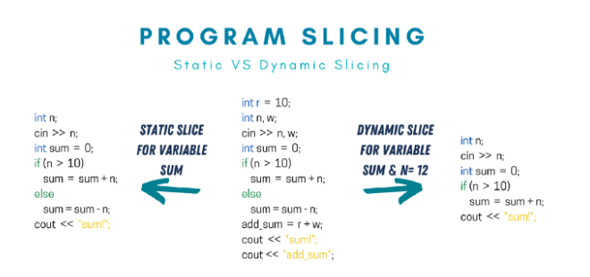

Slide 15
Trace-Based Debugging: Slicing
Conditional slicing: In static slicing, we provide nothing about the input. In dynamic slicing, we construct it based on a specific input. Conditional slicing lays somewhere in the middle. In a conditional slice, we can provide information to the slicing tool about the input without being so specific about precise values.

Slide 16
Trace-Based Debugging: Slicing
Amorphous slicing: All previous slicing discussed so far represents syntax preserving. These approaches are constructed by deleting the statements that don’t affect the set of variables in question. However, amorphous slices are constructed using any program transformation, which simplifies the program while preserving the functionality of the overall program.

Slide 17
Trace Debugging
In trace debugging (TD), the debugger can set a breakpoint, and when a breakpoint is reached during program execution, the program is suspended. Then, the programmer can examine the program state by running it line by line. The debugger takes control over the interpreter only, and hence the scalability of TD is the same as that of the interpreter. During the process of finding the location of a bug, if a bug is found before the breakpoint, then the debugging process needs to restart to catch it.

Slide 18
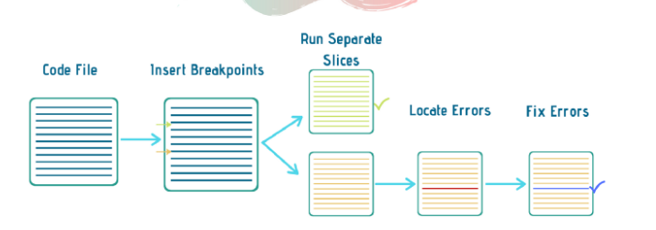
Trace Debugging

Slide 19
Omniscient debugging
In omniscient debugging (OD), also known as back-in-time debugging, the debugger can trace the computations of the program both backward and forward. In this type of debugging, execution traces are enormous, and storing them is a challenging task, so the scalability of OD is quite tricky.

Slide 20
Algorithmic debugging
Algorithmic debugging (AD) is a semi-automatic debugging technique that produces a dialog between the debugger and the developer to find bugs. So, there is no need to see the code to perform the actual debugging. That’s why the level of abstraction of AD is high. AD is done in two phases: First, it builds the execution tree of the given program. Then, the execution tree made is explored in full detail.

Slide 21
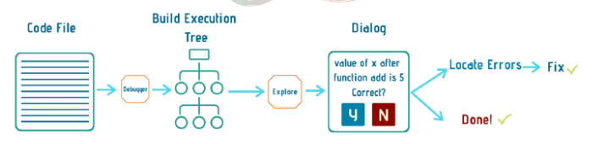
Algorithmic debugging

Slide 22
Hybrid debugging
Hybrid debugging (HD) is a debugging technique that combines trace debugging, omniscient debugging, and algorithmic debugging. First, it uses trace debugging to find out the part of the program where the error occurs. Then, it uses algorithmic debugging on only that part of the program and produces its execution tree. Afterward, it applies omniscient debugging to a single method where algorithmic debugging identified a bug.

Slide 23
Spectrum-Based Debugging
In spectrum-based debugging, also known as spectrum-based fault localization (SFL), the debugging process is done by monitoring the statements included in a particular execution tree.
This is achieved by using the program spectrum to identify the active part of the program during its run.

Slide 24
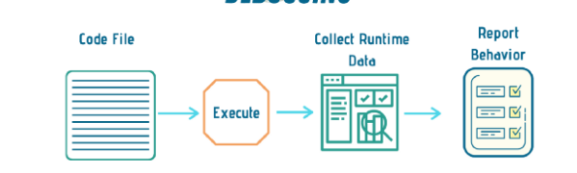
Spectrum-Based Debugging

Slide 25
Spectrum-Based Debugging
The program spectrum is a collection of runtime information that gives a view of the dynamic behavior of the program.
It includes some flags corresponding to different parts of the program.
Different types of program spectra exist, such as block hit/miss and function hit/miss.
These spectra are used to pinpoint the exact sections of the code running for specific or abstract input.

Slide 26
Delta Debugging
The process of delta debugging (DD) is to minimize automated test cases.
It takes test cases that may cause the error and prepares an error report. From that error report, minimal test cases are selected based on their high probability of producing the error.
The minimum test cases will regenerate the same error and thus help the developer locate the bug behind it.

Slide 27
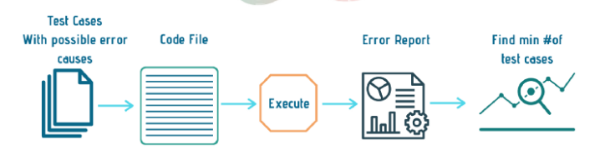
Delta Debugging

Slide 28
References
Department of computer Science
[PDF] Systems Programming and Operating Systems by Dhamdhere - Free Download PDF (dlscrib.com)
[PDF] Principles of Compiler Design By Alfred V. Aho & J.D.Ullman Free Download – Learnengineering.in

Slide 29
THANK YOU

